Slide 1
Rave Cat Reflex Testing
Medha Nair and Asmita Wankhede

Slide 2
Project Brief
The player connects to the mini rave stadium through Bluetooth and presses play on the app screen.
The song starts, starting the game. Rave songs have clearly audible rhythmic intervals where a sample is played.
There is a button on the stadium that must be pressed at these intervals to make the DJ visualizer move. In this song, it’s a spinning cat.
According to accuracy of your DJ-ing, you will be given a score at the end of the song.

Slide 3
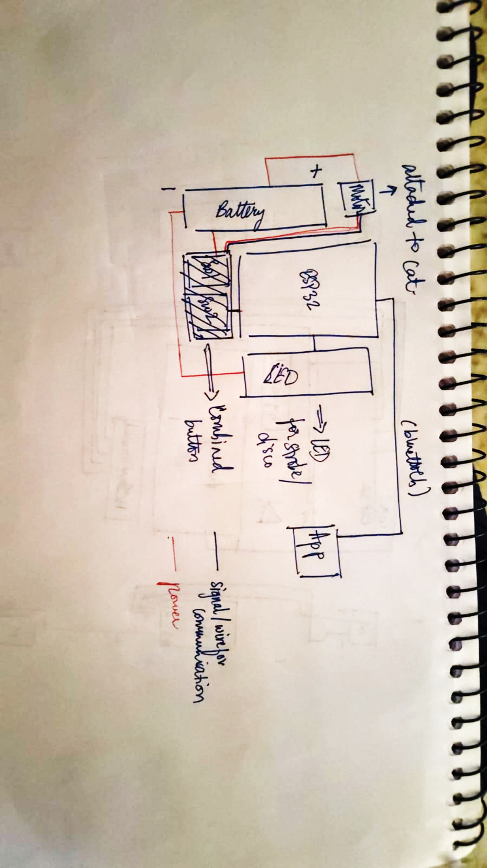
Circuit Diagram

Slide 4
Code Explanation
This code turns an ESP32 into a Bluetooth‑controlled strobe‑response game.
A strobe LED on Pin 26 flashes rapidly in a pseudo‑random pattern while the user presses a button (Pin 25) in sync.
The system measures the duration of each button press, compares it to a known “correct” sequence (og_oiia), and computes a score reflecting how closely the user’s timing matches the original pattern.
The ESP32 connects to a phone app can send a start command and see the score as a percentage.

Slide 5
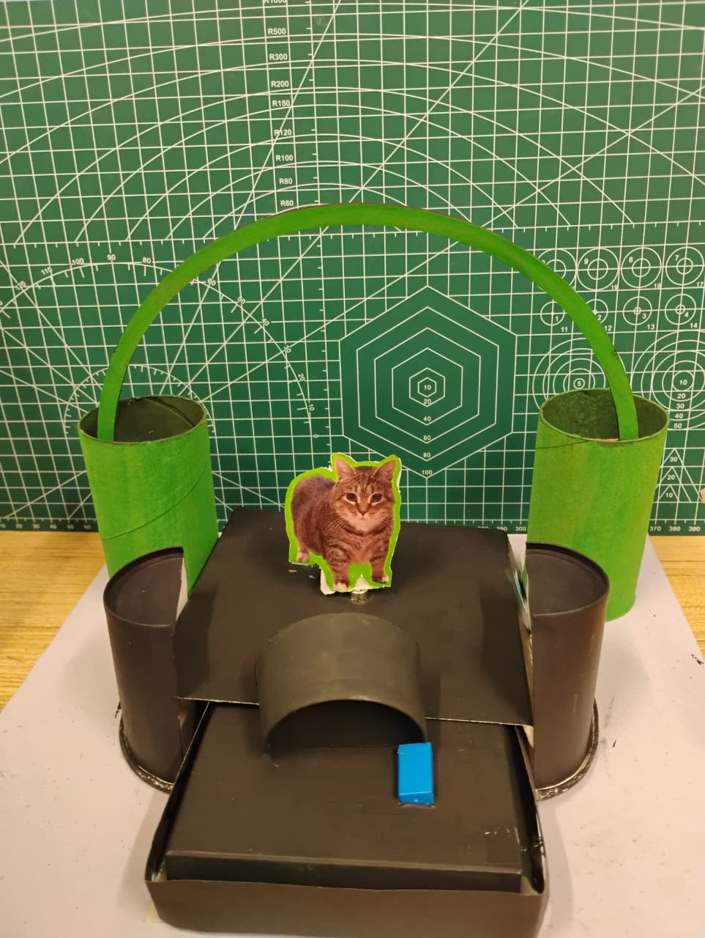
Pictures

